Slide 1
NIOS Processor Interrupts
Engineering 304 Lab

Slide 2
What are Exceptions or Interrupts?
Exceptions and interrupts are unplanned events that the system must respond to.
Examples
Packet of data received from another system
Potential buffer overflow problem
Invalid opcode in an instruction
Illegal math operation
“Sleep” button pressed
Power supply losing power
Keyboard entry has occurred

Slide 3
Handling External Inputs
Polling Method
Main routines in software continually check I/O devices to see if anything has arrived (e.g. lab 5 and the TO flag)
Interrupt Method
CPU runs normal code
Interrupt Service Routine (ISR) is special code, written to handle interrupts
CPU hardware detects an interrupt signal and causes normal code to be suspended and the ISR to be executed
After ISR completes, normal code is resumed
A mechanism is sometimes needed to communicate between ISR and normal code

Slide 4
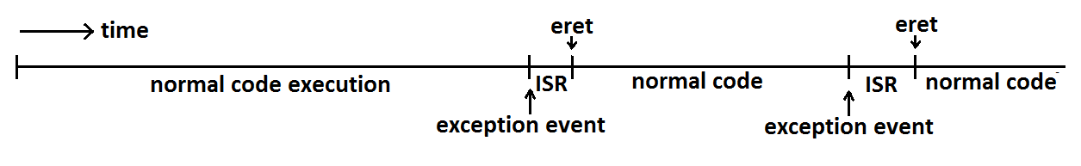
Interrupts
ISRs have some similarities to a function called at random times by hardware-based events
Must protect all registers except et (=r24) and ea (=r29) registers while running the ISR code
Normal code should not sense anything happened except via the communication mechanism
et and ea are exclusively used by interrupt service routines
Multiple levels of interrupt enabling is common

Slide 5
Sources of NIOS Interrupts/Exceptions
Three common types of exceptions
Invalid instruction
E.g. mul r2, r16, r2 when there isn’t hardware for doing multiply
E.g. invalid opcode found in the op field of the machine code fetched
Math errors
E.g. divide-by-zero errors and others that might be implemented
External Interrupts
I/O ports capable of asserting the “int” interrupt signal
NIOS allows up to 32 different I/O ports to each cause an interrupt
We are only using two: timer timeout and key press edge detection
E.g. timer times out and causes an interrupt to the CPU

Slide 6
Turning on NIOS Interrupts
Begin by enabling interrupts in each port
Usually an enable bit in a port register must be set (e.g. MASKing)
Next, be sure any current interrupt conditions are cleared
Clear any interrupt-generating flag bits in the port registers

Slide 7
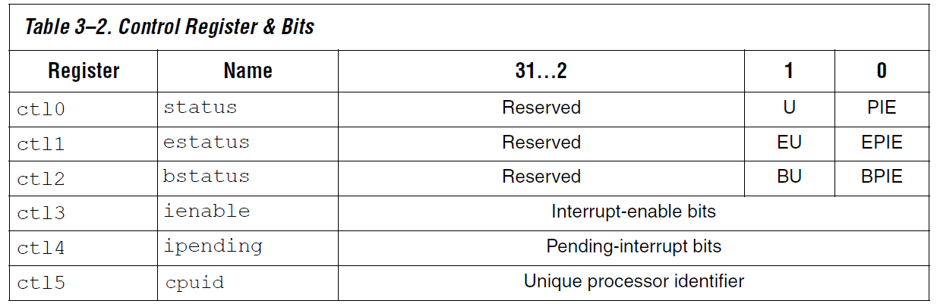
Turning on NIOS Interrupts – cont.
Next, enable the desired port interrupts in the CPU
By setting the bits high in the IENABLE register (CTL3, not CT13)
Finally, set the PIE bit in the CPU STATUS register (CTL0) to enable interrupts globally on the CPU
Note, “rdctl” and “wrctl” instructions allow you to access the CTLx registers to set or clear specific bits

Slide 8
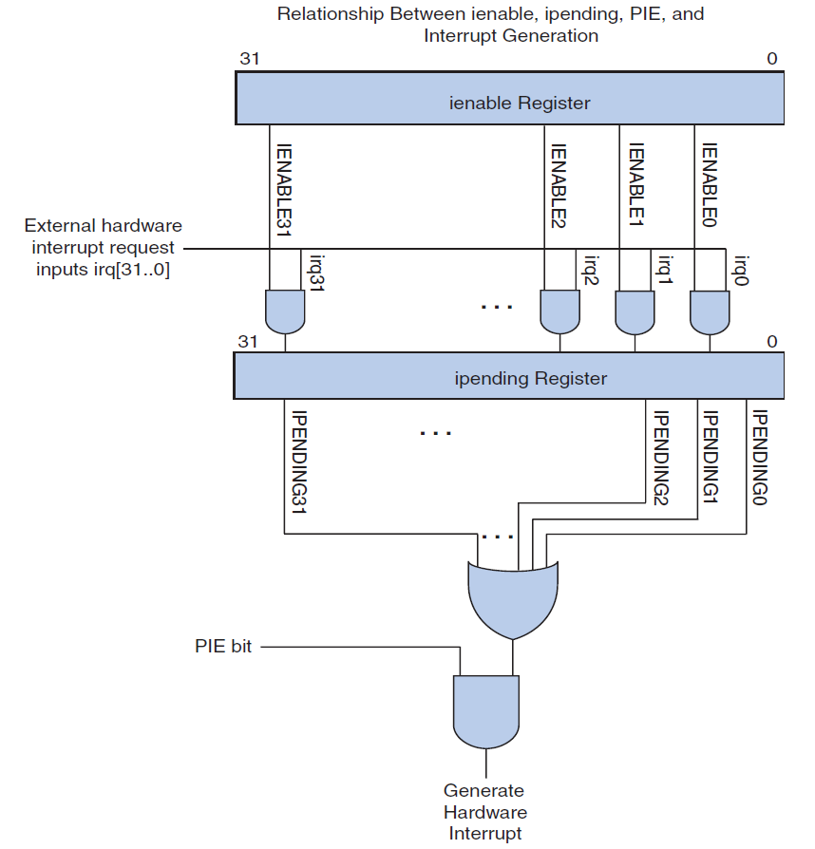

Slide 9
NIOS Interrupt Execution Sequence
An interrupt condition in an I/O port causes “INT” signal to be asserted
CPU hardware copies the PC to the EA register (like RA) and copies the STATUS register (CTL0) to the ESTATUS (CTL1) register (backup)
CPU hardware disables further interrupts (clearing PIE bit)
CPU hardware sets the PC to the address of the ISR
ISR software is executed, clearing interrupt conditions, handling the interrupt, and communicating with the main program as needed
The last ISR instruction is “eret” which restores CTL0 and restores the PC (based on the EA register) (like “ret”)

Slide 10
Creating an ISR
Begin by pushing any register used besides ET and EA
Next, the code must correct the EA register if the exception is from an external interrupt
Each of the up to 32 possible interrupts are checked one at a time
IPENDING register (CTL4) holds flags for each interrupt port
For each pending interrupt, ISR needs to
Communicate with normal software routines (e.g. global variable) or take the appropriate action if it is simple
Clear the port register flag that is causing INT to be asserted (e.g. TO bit)
Pop any registers pushed on the stack
End the ISR with the “eret” instruction

Slide 11
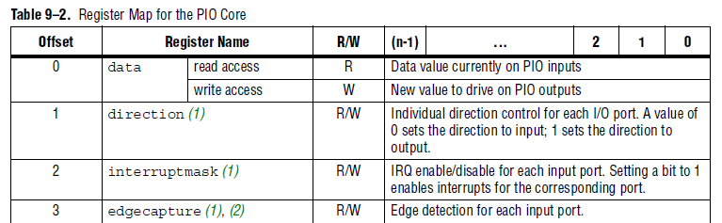
PIO Core (Peripheral I/O device/port)

Slide 12
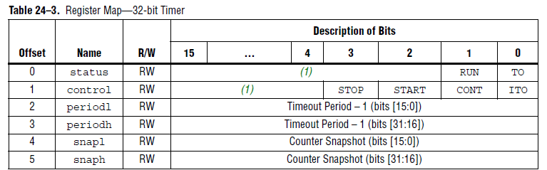
Interval Timer Core

